Slide 1
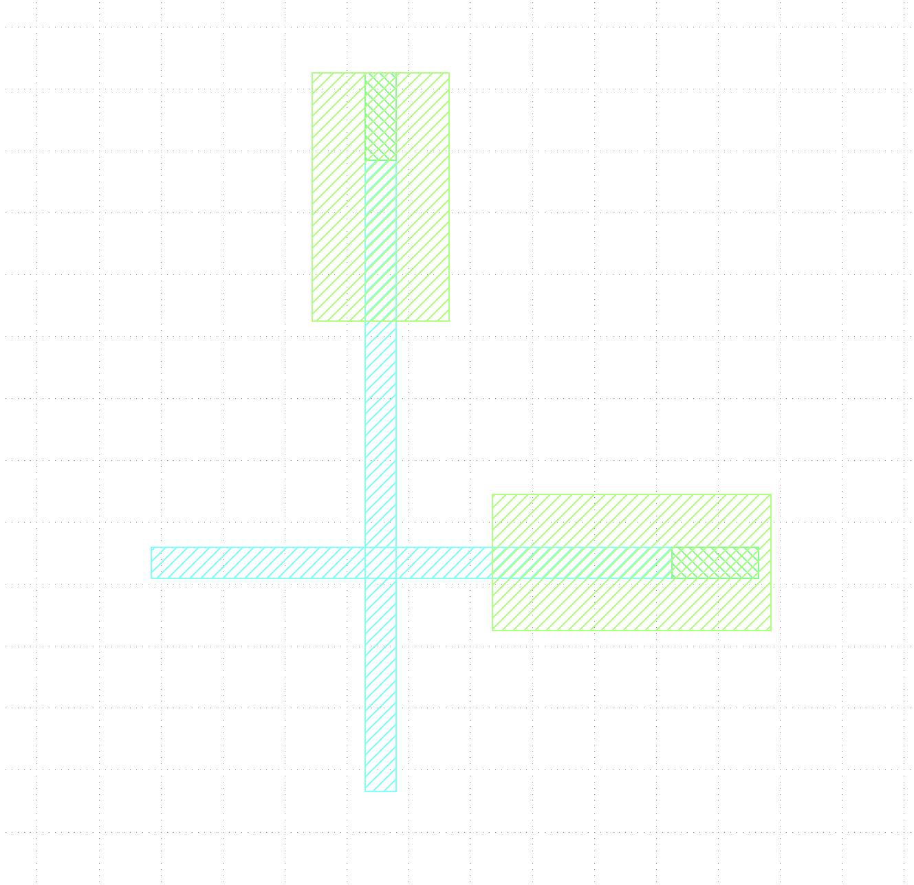
Guide to Plassys
Vent the chamber.
Click on low-torque/high-torque button in the Planetary motion box. Make sure it is showing LOW TORQUE.
Unscrew the bolts with hands only.
Take out the sample holder
Loosen the screws to allow for movement of metal springs/wires.
Load you sample with following instructions.
Loading to Plassys
Keep your sample holder as shown in fig 1 with three
holes/pins at the top part.
2. Keep your sample orientation such that your junctions
Are aligned like fig 2.
Keep in mind here the direction of deposition according to
Recipe needs you to have direction 1 (red for deposition 1)
and direction 2 (black for deposition 2) in the given order.
Fig. 1
Fig. 2

Slide 2
After Loading
Put the sample holder back to chamber.
Hand tight the screws again.
Rotate the sample mount to align as shown in fig 3.
Close the chamber.
Put the planetary setting back to HIGH TORQUE.
Reset the position of planetary to zero by clicking on reset
Button.
7, Pump the chamber.
8. Play the recipe.
Motor outside the chamber

